Slide 1
Case Study
CAR 1 – Chris Nicastro Review – Chris Nicastro to discuss
CAR 2 – Julianne Heinzinger Review – Chris Nicastro to discuss
CAR 3 – Gunsimar Paintal Review – Dale Hendricks to discuss
CAR 4 – Dale Hendricks Review – Dale Hendricks to discuss
Team:
Dale Heindricks, Julianne Heinzinger, Chris Nicastro, Gunsimar Paintal

Slide 2
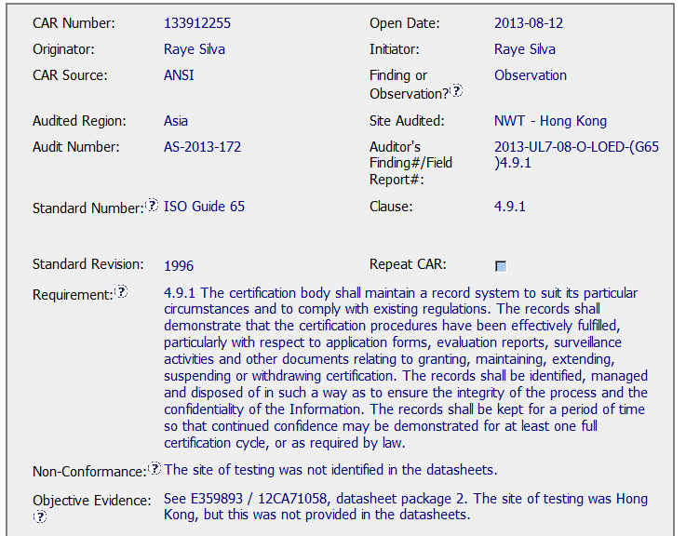
CAR – Sample 4 – CAR 133912255
Closing Meeting Date was
2013-05-22
CAR was not entered until
2013-08-12

Slide 3
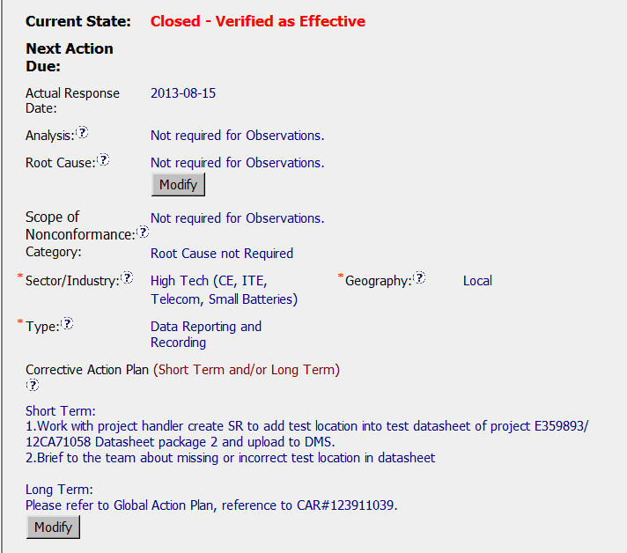
CAR – Sample 4 – CAR 133912255
CAR Process Website FAQ 15 suggests use of the verbiage “Not Applicable”
Sector / Industry for CCN – ATNZ is actually – Appliances / HVAC

Slide 4

CAR – Sample 4 – CAR 133912255
Good response time from owner, 3 days
Good verification statement

Slide 5
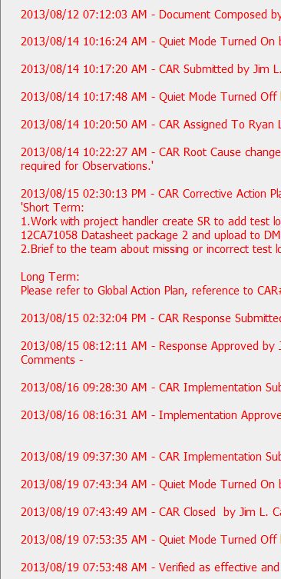
CAR – Sample 4 – CAR 133912255
Not clear on the frequent use of “Quiet Mode,” is it necessary?

